Slide 1






Project of AI Psychologist with Long-Term Memory
2025/10/28

Slide 2



01
Related Work and Key Challenge
02
Technical and Practical Feasibility
03
Value Position
CONTENTS
目录

Slide 3







CONTENTS
目录
1
Introduction
2
Related Work and Key Challenge
3
Technical Feasibility
4
Practical Feasibility
5
Value Position
6
Future Plan

Slide 4



02
Related Work &
Key Challenges

Slide 5
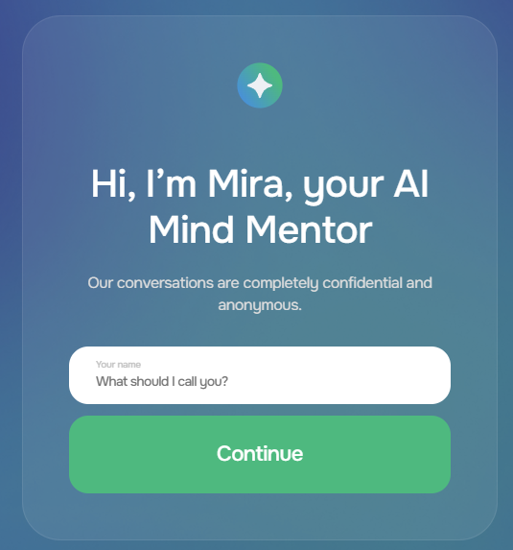

Related Work
Chat bots can play a positive role in intervention for moderate anxiety and depression
Siri can identify 128 emotional states through voiceprint analysis

Slide 6

Key Challenges
Long-term Memory
Speech Recognition
- How to automatically identify and reserve the users' personality and habits as well as meaningful mental events from the consultation.
- At the same time, selectively expired information forgetting to avoid information redundancy and contradictions is also a difficult task.
- Different users have significant differences in their expression methods. A general architecture can not adapt to individual needs accurately. Therefore the assistant need to build user profiles.
- Mental consultation contains a lot of pauses, repeats, interjections and some incomplete sentences. This requires a high level of comprehension ability of the model.
- Delay in speech transcription will disrupt the flow of conversation.

Slide 7
01
SECTIONS
Technical Feasibility

Slide 8



Technology Stack Selection
Python as Core Language
Cost-Effective AI with OpenRouter
Local Vector Databases for Privacy
Python is chosen for its extensive use in AI and NLP, offering a rich ecosystem of libraries and community support, which ensures robust development capabilities.
OpenRouter’s free-tier models provide capable LLM services without API fees, significantly reducing costs while maintaining high performance.
Local vector databases like ChromaDB or FAISS offer efficient similarity search while ensuring that sensitive conversational data remains private and secure.

Slide 9


Five-Layer Memory Architecture Design
Human-Like Memory Layers
Modular and Clear Data Structures
The project‘s designed multi-layer memory architecture includes five levels。 This layered design ensures both the efficiency of memory retrieval and the completeness of information storage.
Working memory is implemented through short-term conversation history records, episodic memory through timestamp-classified storage of conversation fragments, semantic memory through vector database storage of user profiles and knowledge, procedural memory through case libraries and skill libraries, and external persistent memory through hierarchical storage mechanisms.

Slide 10


RAG-Based Retrieval for Personalization
The lightweight RAG pipeline runs entirely on CPU, Reduce computing power costs
This approach eliminates the need for expensive fine-tuning, keeping development costs low while maintaining high response quality.
Combining Retrieval and Generation
Dynamic Context Windows
The RAG technique combines the precision of retrieval with the fluency of generation, ensuring contextually accurate and personalized responses.
The system constructs dynamic context windows from multi-layer memory results, providing highly relevant information to the LLM for better responses.
CPU-Based Pipeline
Avoiding Expensive Fine-Tuning

Slide 11

Offline Voice Interface with Vosk API
Compact and Offline Speech Recognition
Vosk API offers compact 100–200 MB models with offline operation, supporting multiple languages including Chinese, ensuring privacy and low resource usage.

Slide 12
02
SECTIONS
Practical Feasibility

Slide 13







Minimal Resource & Cost Profile
Modest Storage Requirements
The project requires only 200–300 MB for speech models and 1–2 GB for vector databases and memory storage, fitting easily on standard laptops.
1
CPU-Based Inference
The design avoids GPU dependency, with major computing tasks executable on CPU, Enables the application scenarios to cover a wider range.
2
Free-Tier Development
Development and testing leverage entirely free tiers, keeping initial costs near zero and ensuring financial feasibility for student projects.
3

Slide 14
04
SECTIONS
Value Proposition

Slide 15


Target users: Everyone want to improve mental health
Tencent Research Institute (2024)
98% people would like to use AI accompany to resolve social difficulties
AI accompany: an extended concept of AI psychologist
Aktan et al., 2022
55% of about 800 participants above 18 years old perceived AI-based psychotherapy positively.

Slide 16


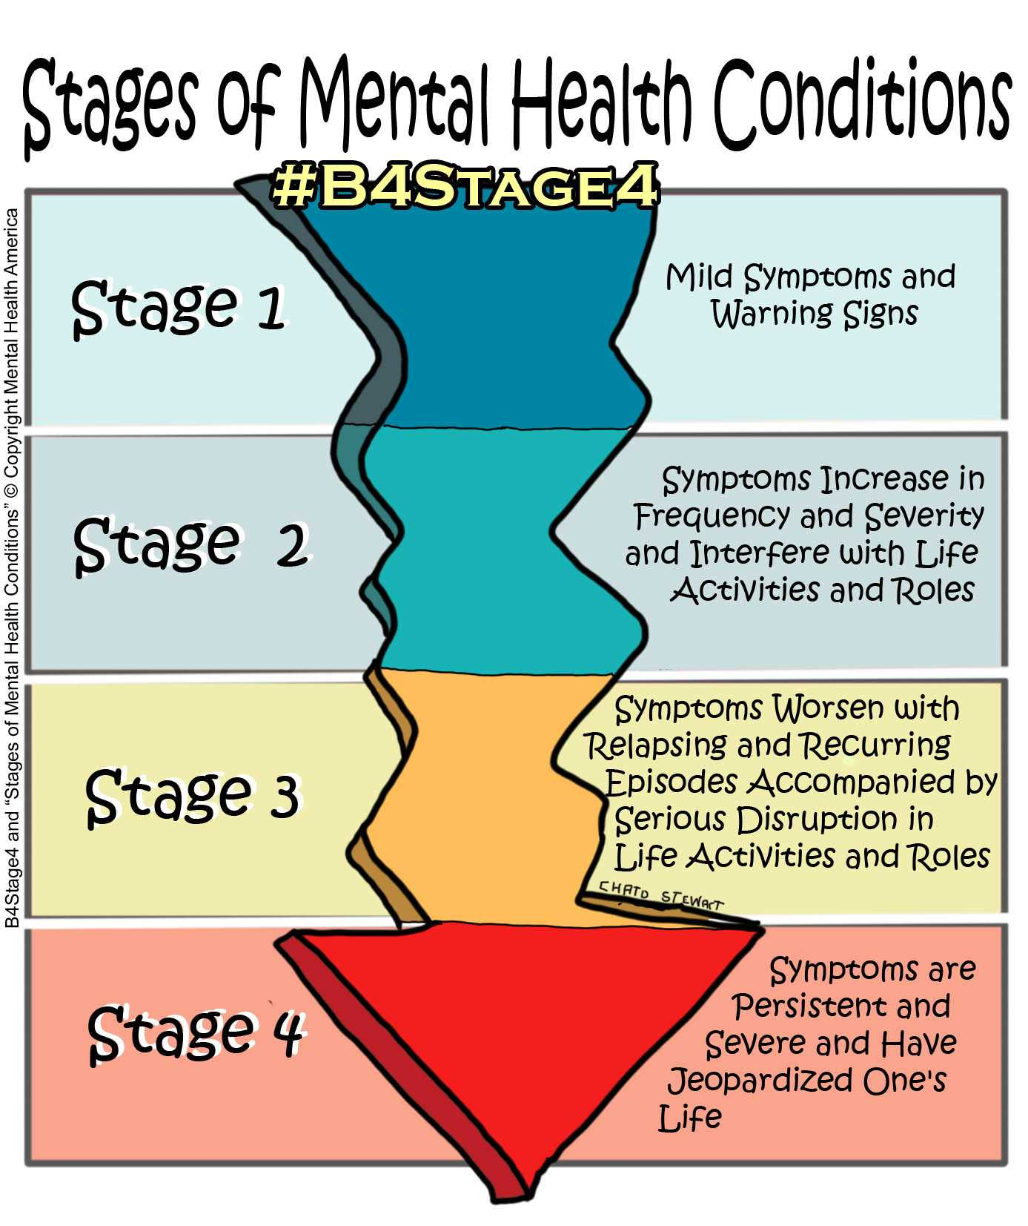
Valuable aspects with unique use scenarios
Convenience
Not every negative emotion will result in psychologic diseases, but it is not a good choice to maintain negative mood for a long time.
Not convenient to do psychological consult.
AI psychologist can be a better choice.
More convenient
Not a serious problem to spend much time consulting a psychologist.

Slide 17
Timeliness
Major depressive disorder，MDD:
high prevalence, high relapse rates, and high disability rates
episodic
Mental diseases attack
Timely psychologic cure
Psychologists can’t stay with their patients all day. It can cause serious results.
AI psychologist can assist psychologists when they are absent due to personal events

Slide 18

Privacy
Aktan et al., 2022
The majority trusted more human psychotherapists than AI-based systems.
However, AI-based psychotherapy was identified as being able to comfortably talk about embarrassing experiences.
Unlike humans
AI won’t do personal value judgment. It will try the best way to improve mental health

Slide 19




Coverage
Human psychologists
AI psychologist
Most people would like to live in a comfortable place.
Mental resources are distributed unfairly.
Cover every region only require necessary digital device.

Slide 20

THANKS

